Slide 1
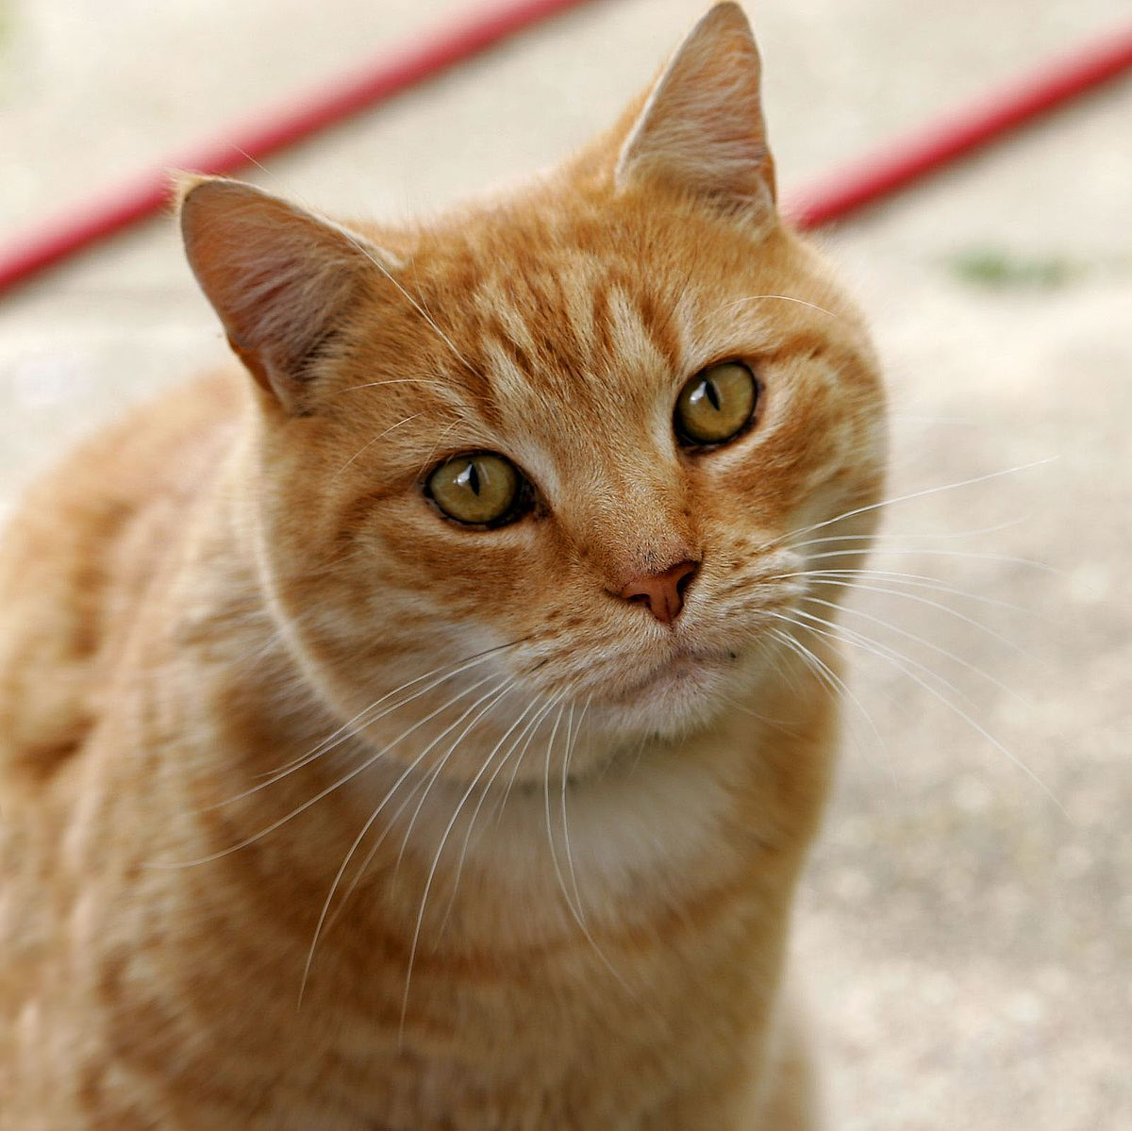
Cat
The cat (Felis catus) is a domesticated species of small carnivorous mammal.
It is the only domesticated species in the family Felidae.

Slide 2
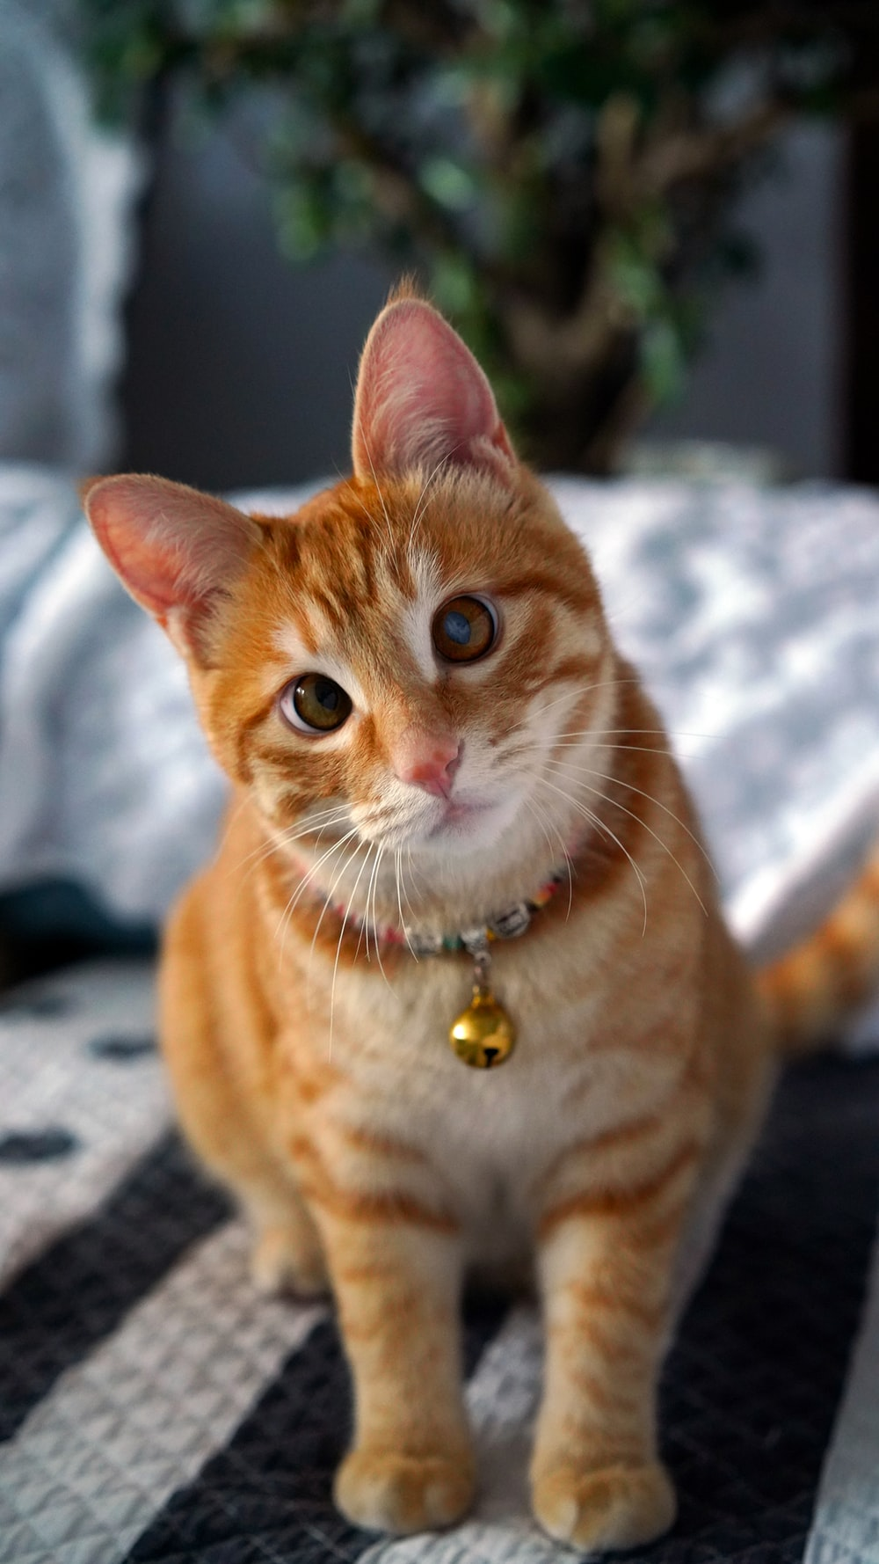
Etymology and naming
The origin of the English word cat is thought to be the Late Latin word cattus, which was first used at the beginning of the 6th century.

Slide 3
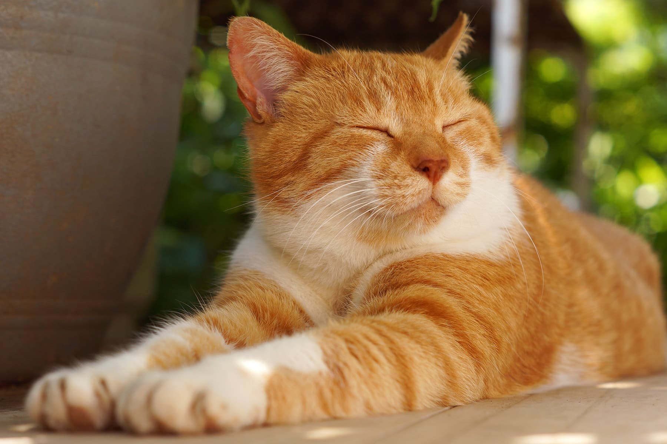
Taxonomy
The scientific name of the domestic cat is Felis catus.
The domestic cat is a distinct species, namely Felis catus.

Slide 4
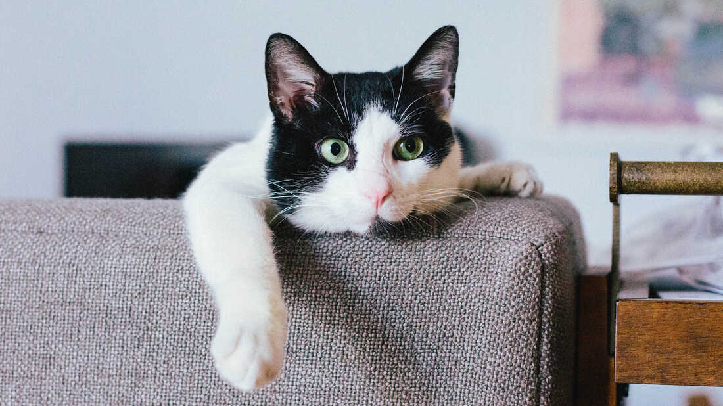
Evolution
The domestic cat is a member of the Felidae, a family that had a common ancestor about 10–15 million years ago.

Slide 5
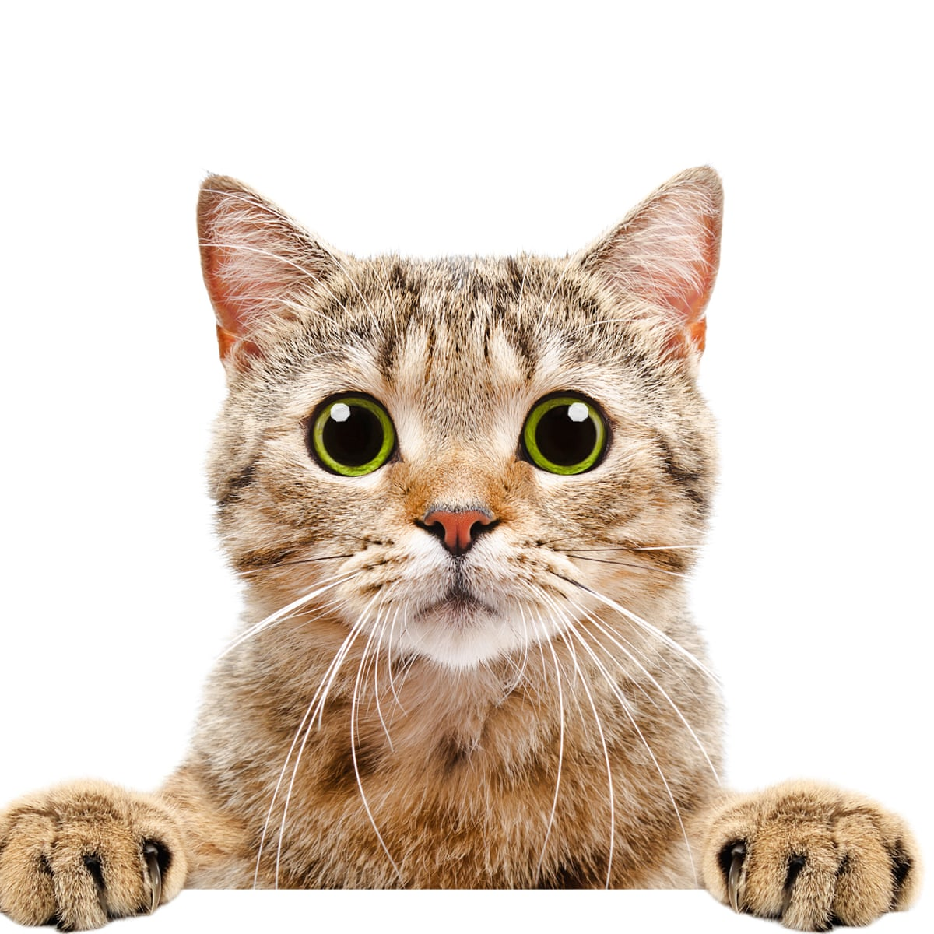
Characteristics
The domestic cat has a smaller skull and shorter bones than the European wildcat.

Slide 6
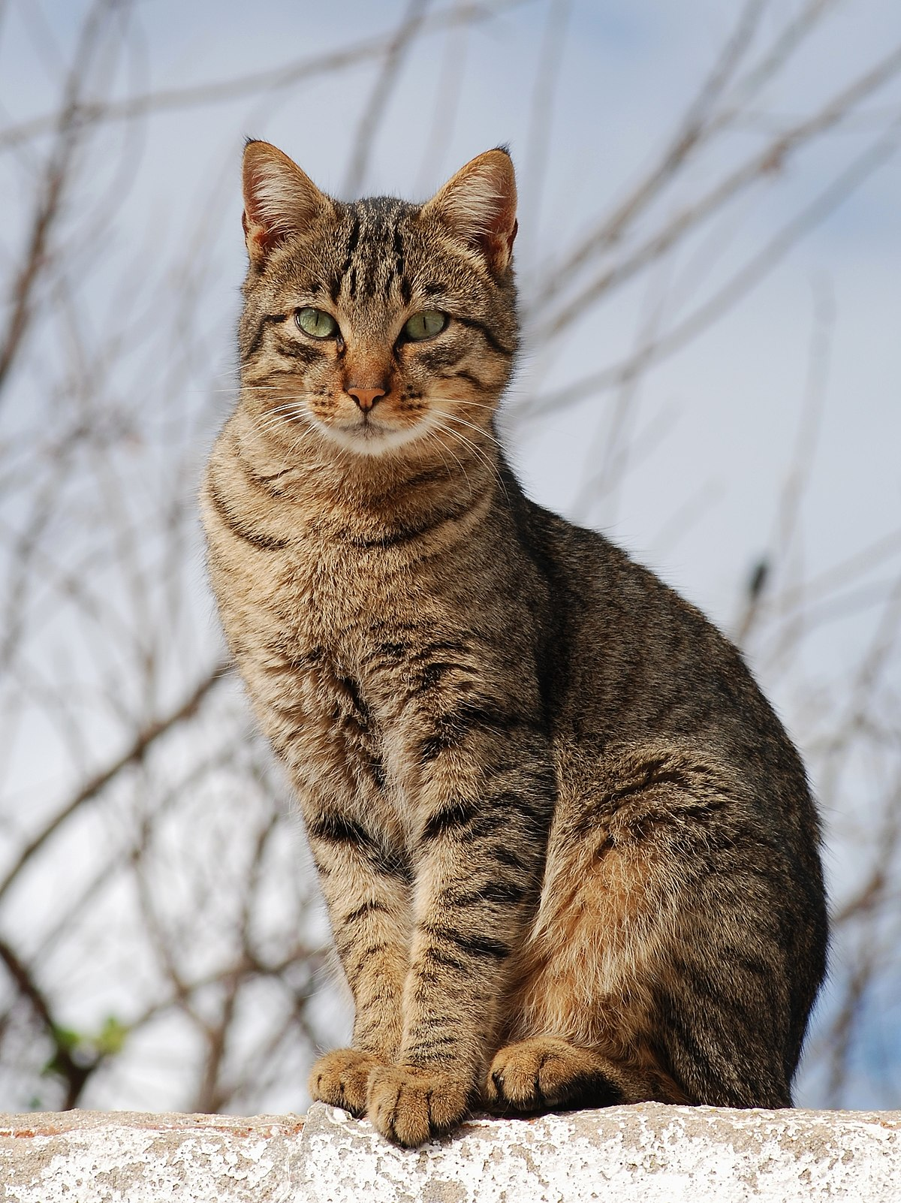
Senses
Cats have excellent night vision.
They can see at only one-sixth the light level required for human vision.

Slide 7
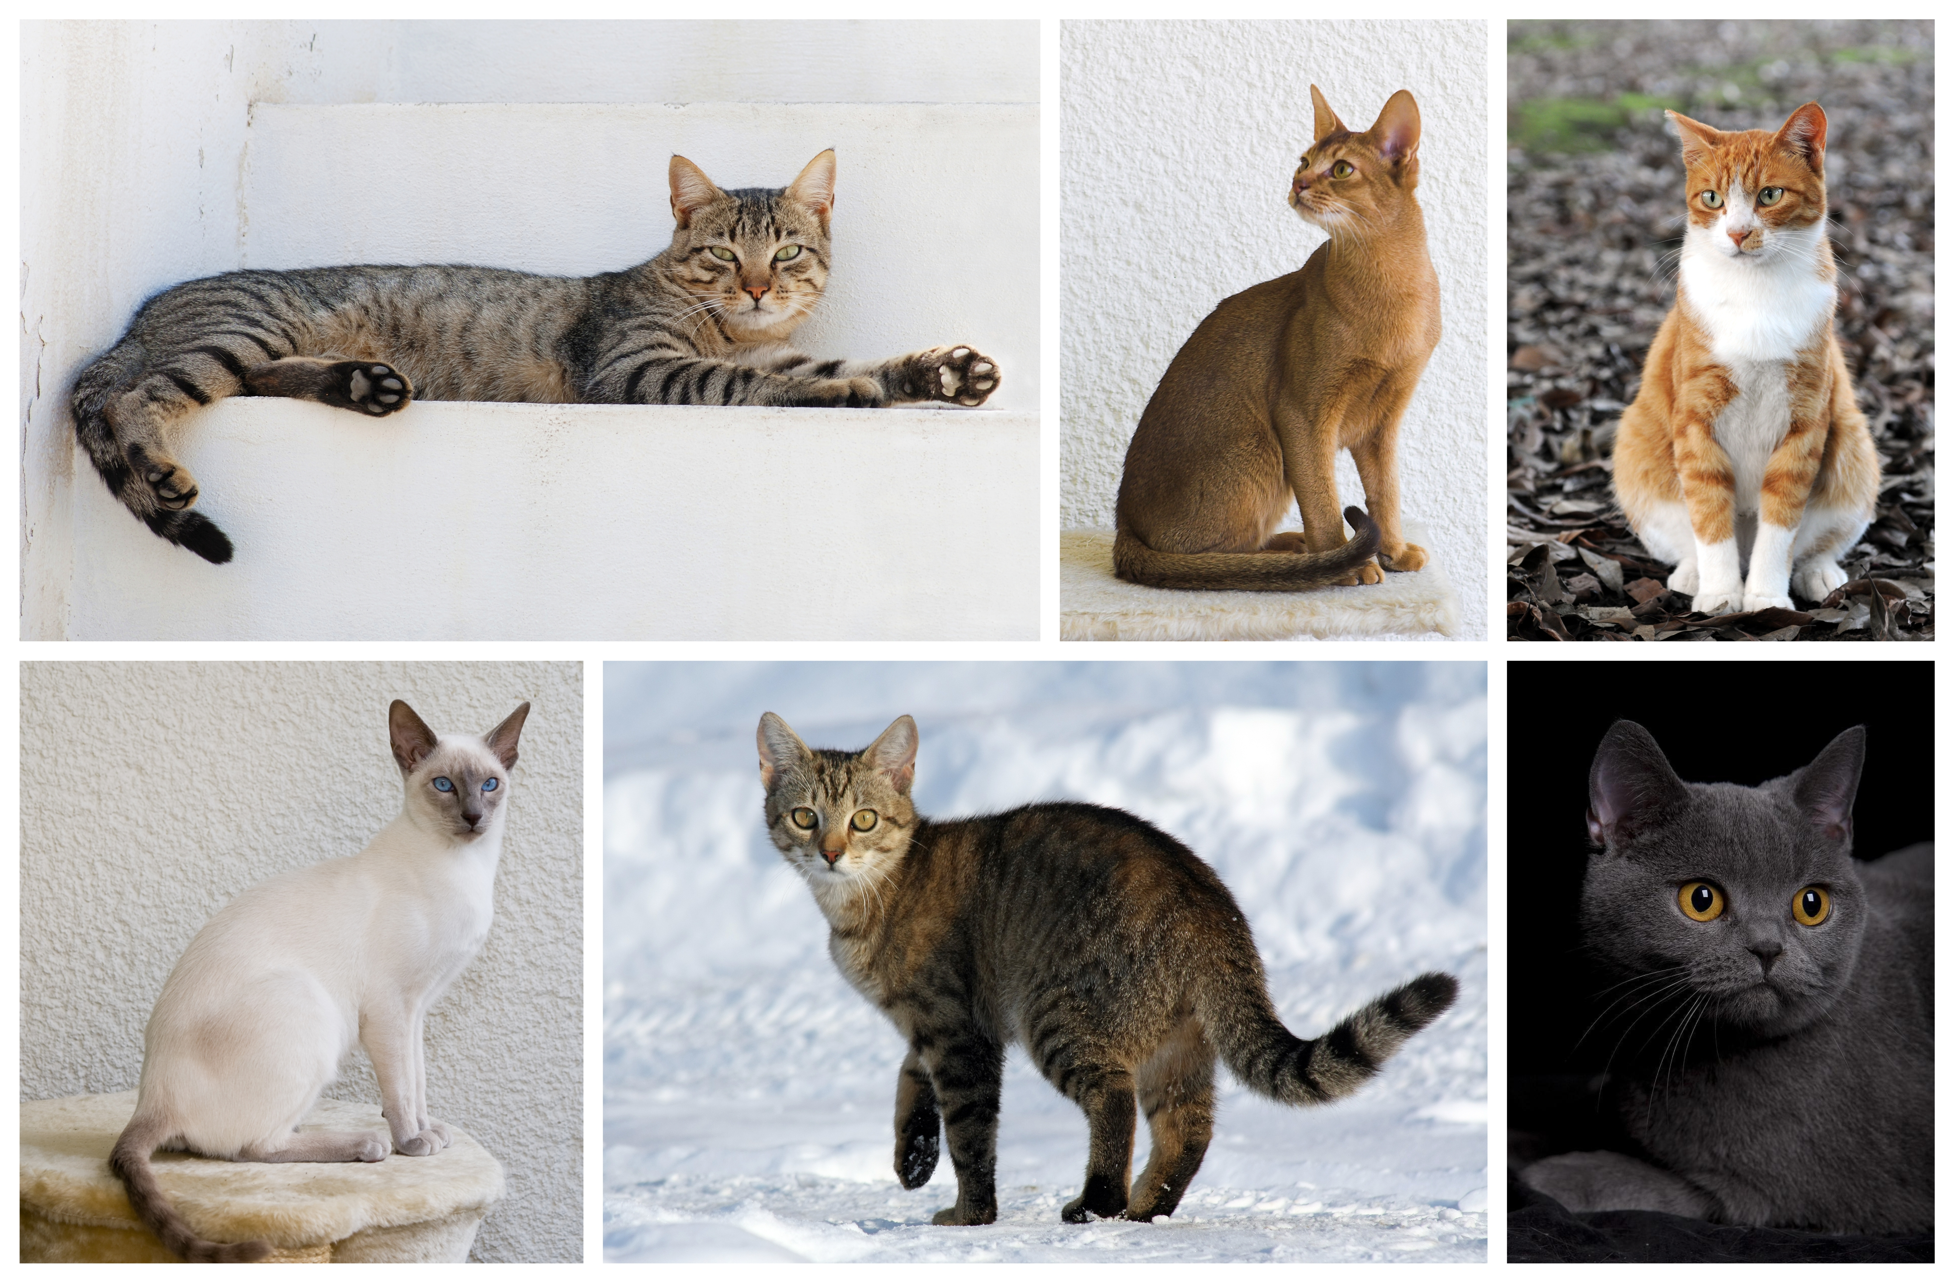
Behavior
Outdoor cats are active both day and night, although they tend to be slightly more active at night.

Slide 8
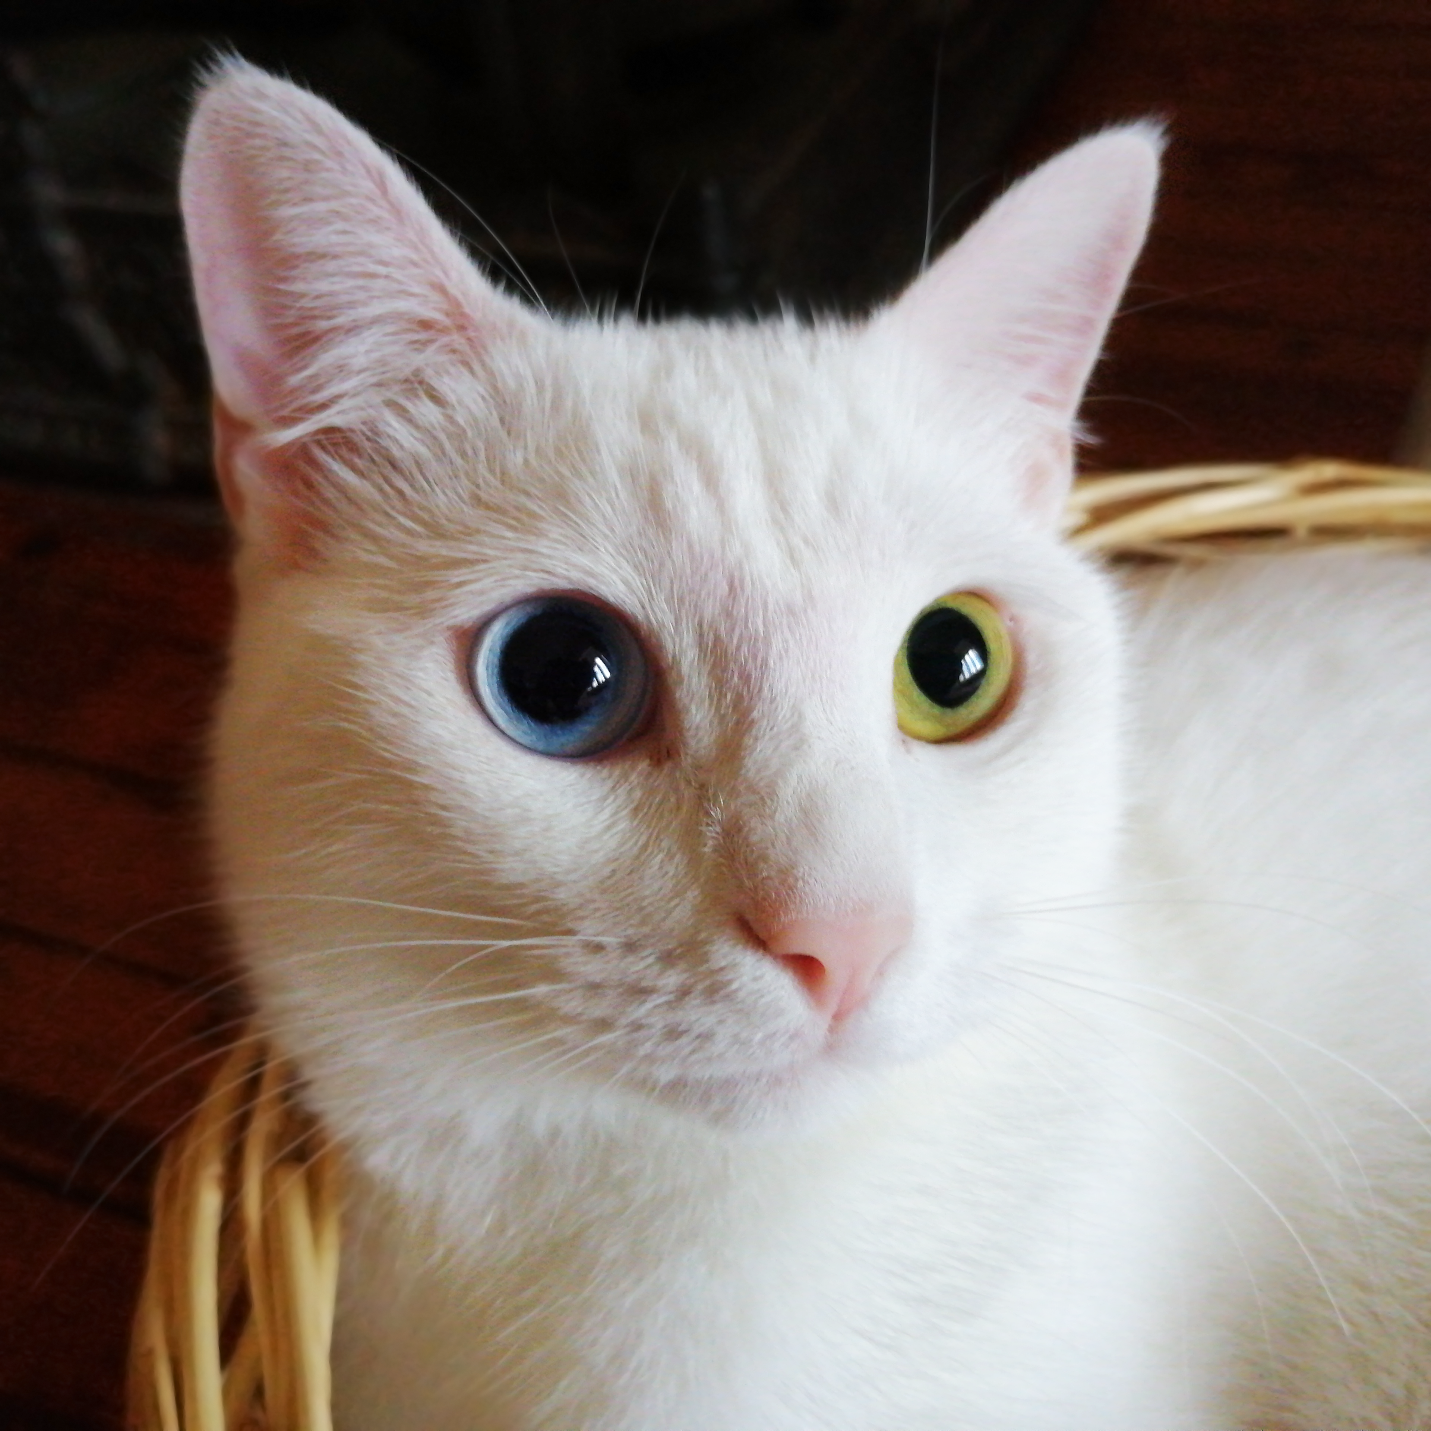
Lifespan and health
The average lifespan of pet cats has risen in recent decades.
In the early 1980s, it was about seven years,: 33 rising to 9.

Slide 9
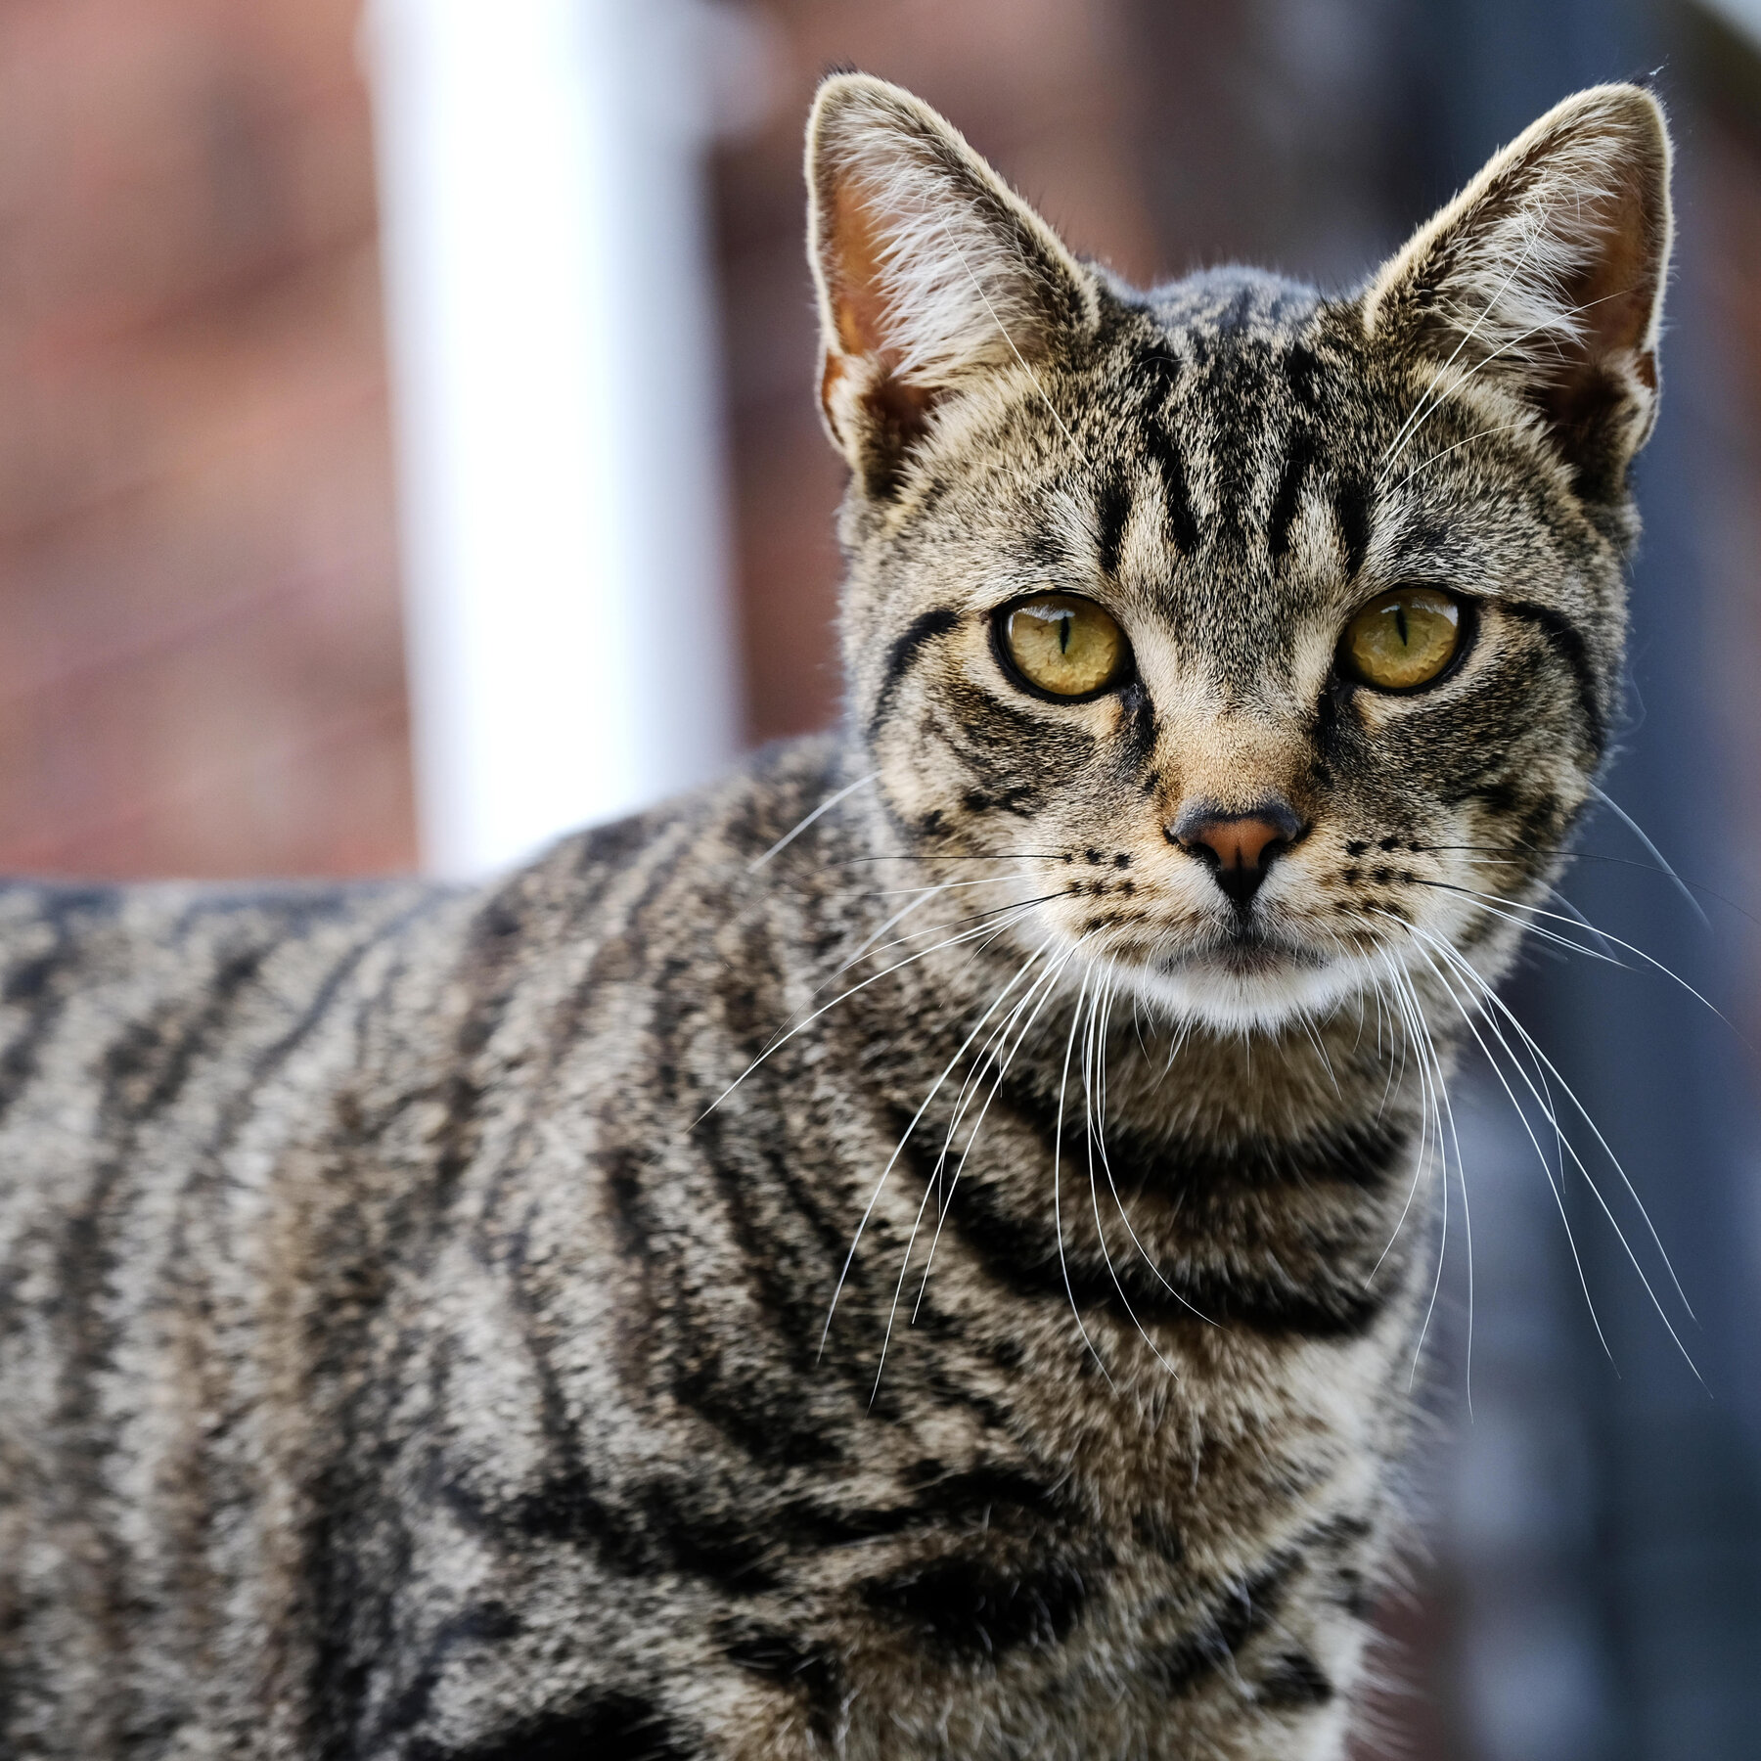
Ecology
The domestic cat is a cosmopolitan species.
t occurs across much of the world.
t is adaptable and now present on all continents except Antarctica.

Slide 10
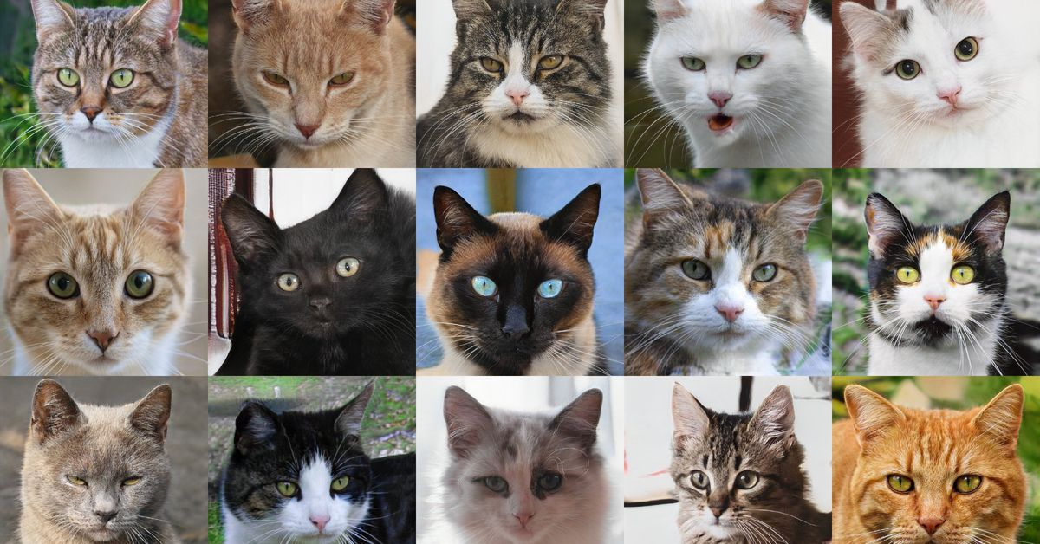
Interaction with humans
Cats are common pets throughout the world.
They have been used for millennia to control rodents.

